Slide 1
Vehicle Detection and Descriptive analysis Subject –AI and ML Capstone Project Instructor – Vahid Hadvi
Presenters: Urvashi Patel (C-0787478)
Surjeet Virdee (C-0790292)
Rajkumar Patel (C-0801561)
Jasbir Singh (C-0792107)
Tirth Rami (C-0778787)

Slide 2
Content List
Introduction
Summary
Team

Slide 3
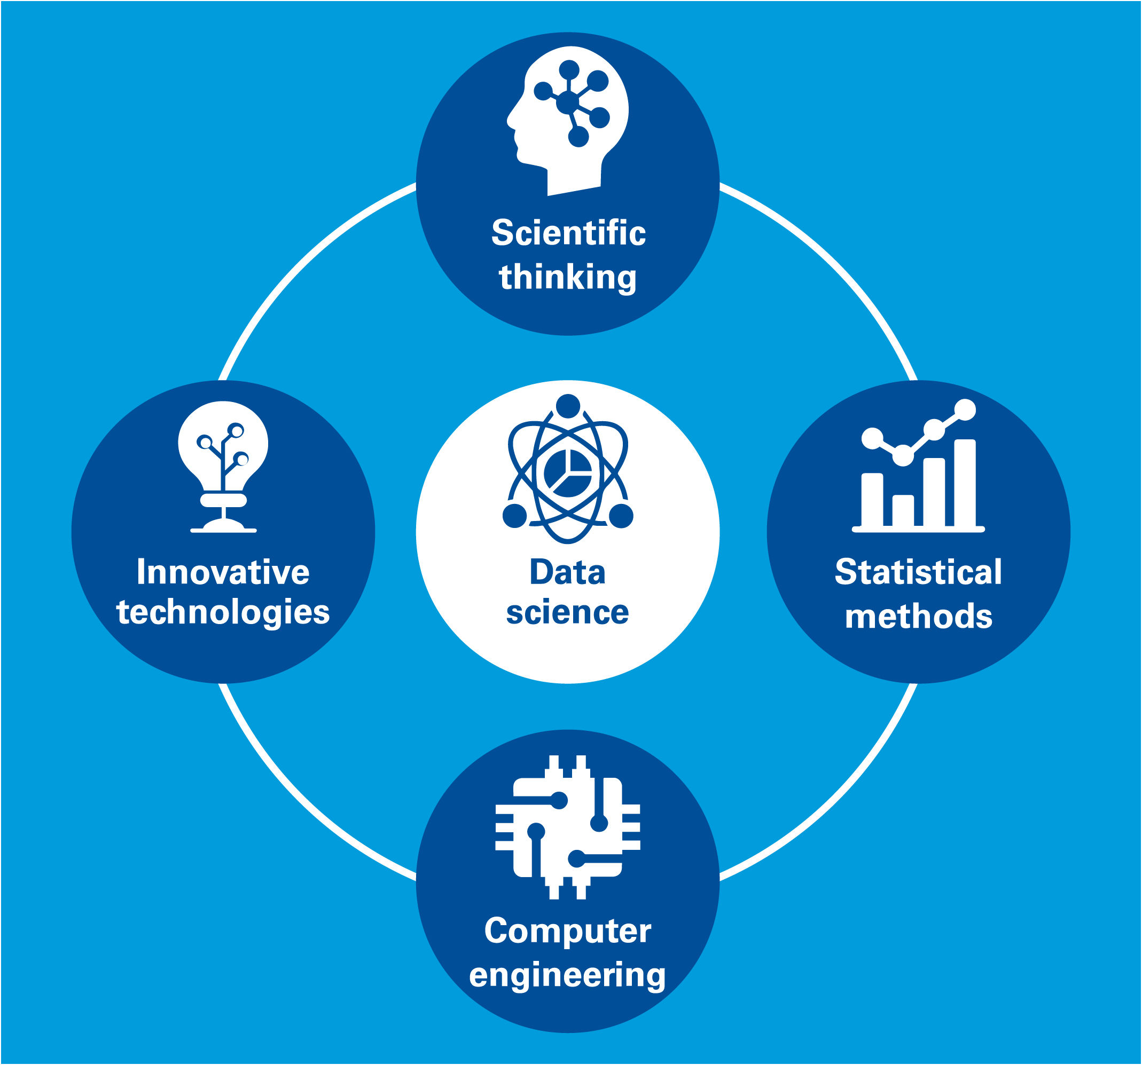
Introduction
This presentation will present the basic steps of data analysis, on a data collected by internet survey and which is available free for analysis. There are certain steps applied on the data, such as pre-processing (importing data, cleaning the data, visualizing the data, preparing the data for model building), model building (applied Naïve Bayes classifier) and applying it on pre-processed data.

Slide 4
Project Explanation
Pre-processing
Model Building
Results

Slide 5


Summary
Numbers of users purchases the items on internet, and they use reviews for item purchasing, as a student of artificial intelligence and machine learning we developed a program to apply a machine learning model to check if the given stars are reliable for given text reviews. The output of the prepared model shows that it was around 67 % accurate to predict the review star from the text.

Slide 6
Updates
Different analysis can be applied such as sentimental analysis, particular review was positive or negative
For prediction different classifiers, regression models and many analyses can be applied to this data.
Insights can be derived from this data

Slide 7
Team
Surjeet Virdee C-0790292
Rajkumar Patel C-0801561
Jasbir Singh C-0792107
Tirth Rami C-0778787
Urvashi Patel C-0787478

Slide 8
Thank you

